Slide 1
Milestone 5
Project --- Building A Multi-functional Discord Bot
Submitted By: -
Devesh Jangir
Prince Ahlawat
Abhas Singh

Slide 2
Full Implementation
I have also done full implementation of my project. I have completed as well as implemented most of my functionalities.
The screenshots of which are attached in this & the upcoming slides.

Slide 3
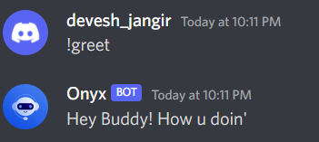
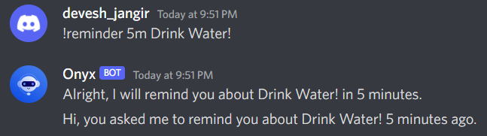
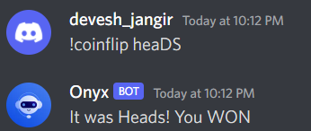
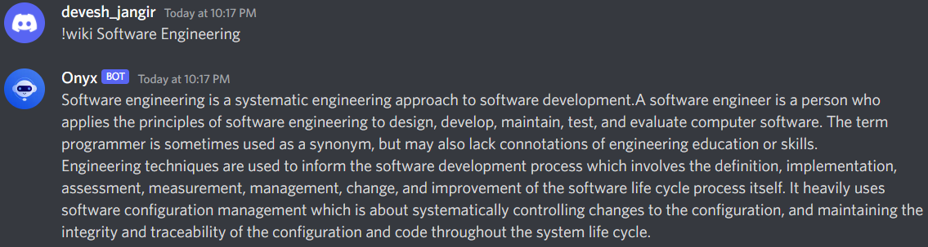
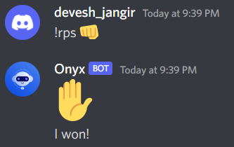
Attach the snaps of the functionalities here:

Slide 4
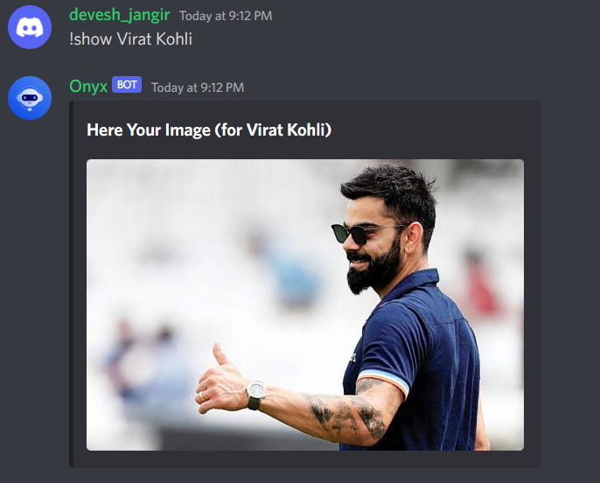

Slide 5
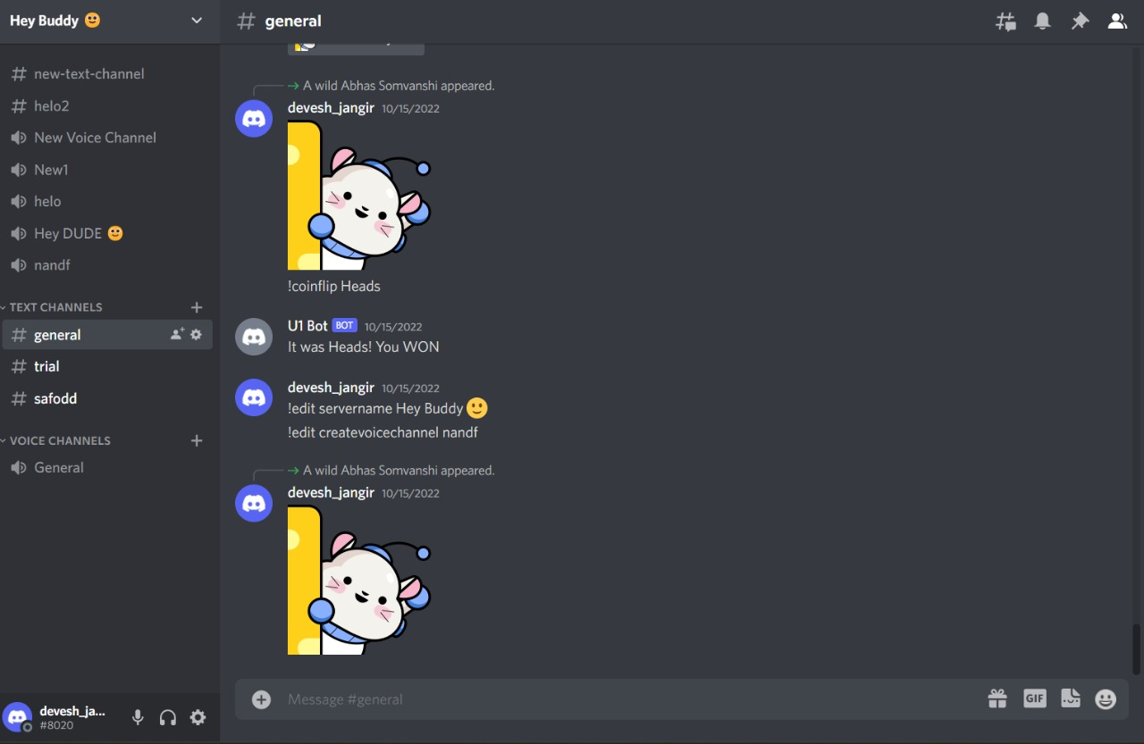
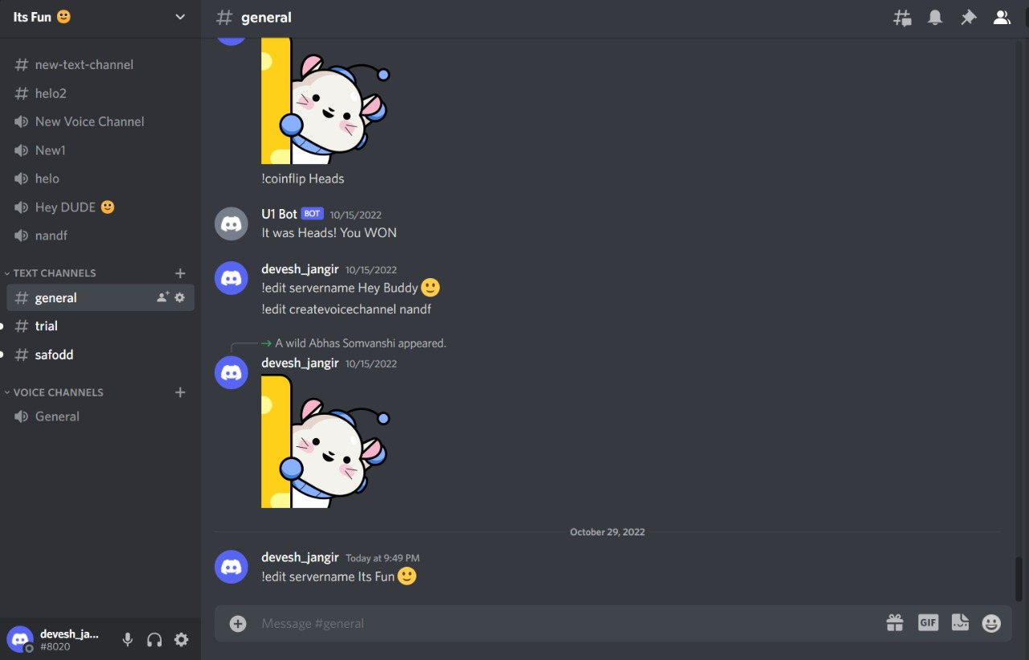
Changing Server Name:

Slide 6
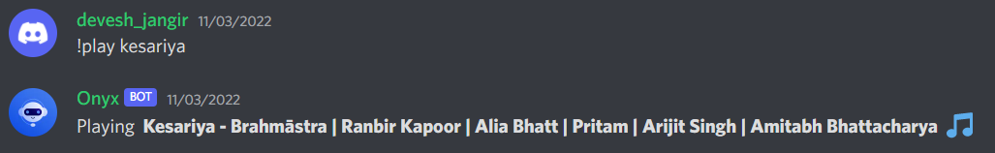

Music Command
Daily Message Event

Slide 7
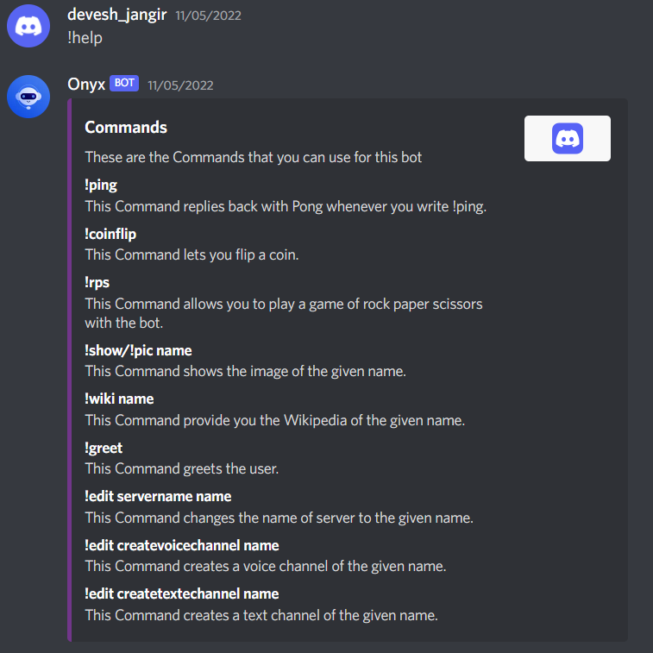
Help Command

